Slide 1
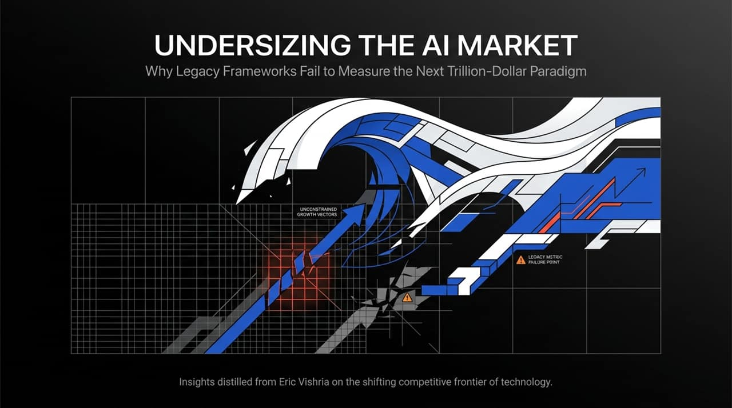
Notes:
Opening: Welcome, everyone. Today, we're talking about why legacy frameworks fail when evaluating the next trillion-dollar paradigm—and why most experts are drastically underestimating the size and trajectory of the AI market.
Core Context: The core insights in this presentation are distilled from Eric Vishria, General Partner at Benchmark. We are seeing a fundamental shift in the technology landscape where traditional software playbooks no longer apply.
Key Takeaway: Just as traditional investors failed to grasp the magnitude of the cloud shift back in 2006, market consensus today is making the exact same error with AI by applying zero-sum, legacy software metrics to an unconstrained, non-zero-sum growth expansion.
https://www.youtube.com/watch?v=0e7aG_MIHlQ

Slide 2
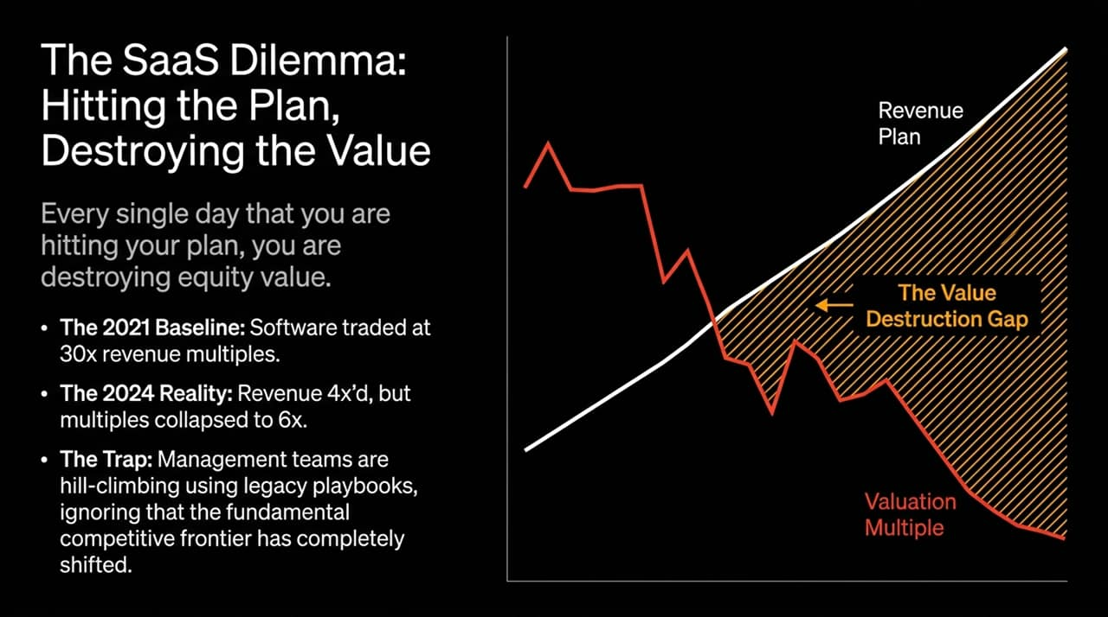
Notes:
The Provocative Thesis: Let's address the most alarming quote in the software industry today: "Every single day that you are hitting your plan, you are destroying equity value."
The Historical Context (2021 vs. 2024):
In 2021, software companies traded at peak valuations—around 30x revenue multiples.
Fast forward to 2024–2026: many public SaaS companies successfully quadrupled their revenues. Yet, because revenue multiples collapsed from 30x down to ~6x, these companies are actually worth less today than when they were smaller.
The Trap: Software management teams have spent their entire careers operating under a simple rule: lay out a plan, execute violently, and build value. But today, management teams are hill-climbing on local maxima. They are spending 8 AM to 5 PM executing their legacy business, and treating AI as a side project from 5 PM to 8 PM.
Actionable Insight: They need to invert that ratio. If you are hill-climbing using legacy playbooks, you are ignoring the fact that the underlying competitive frontier has completely moved.

Slide 3
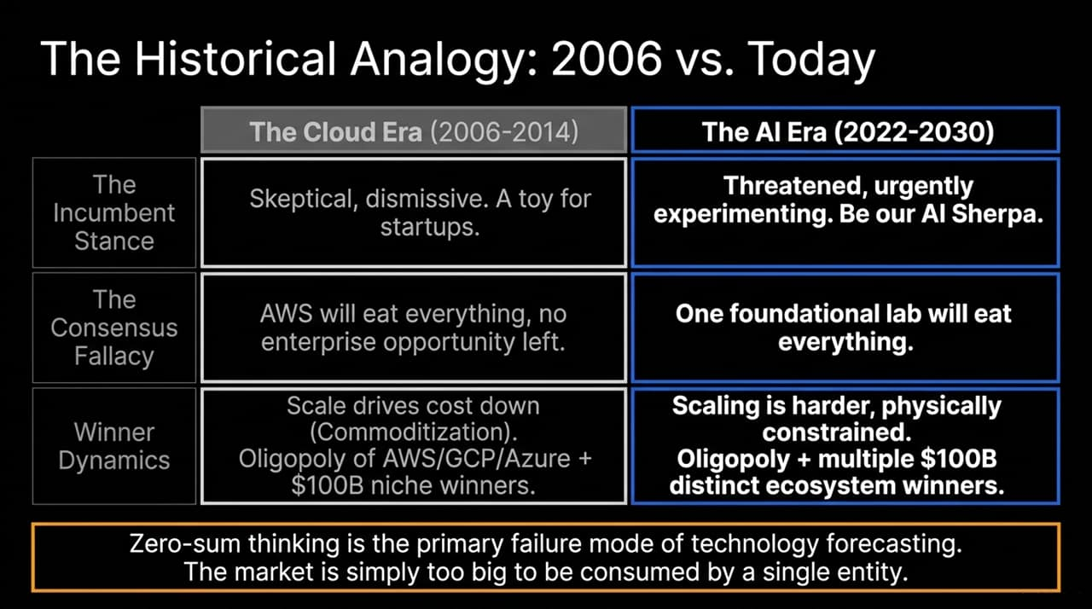
Notes:
Comparing the Eras: To understand where we are, look back at the birth of cloud computing in 2006 when AWS launched S3 and EC2.
The Cloud Fallacies (2006–2014):
2006 Stance: Incumbents were dismissive. Smart investors thought AWS was an uninteresting, low-margin toy.
2014 Stance: The narrative completely flipped to a consensus fallacy: "AWS will eat everything. There will be no enterprise software or database opportunity left."
What Actually Happened: What followed was a massive expansion. AWS didn't swallow the market. Instead, we got an oligopoly (AWS, GCP, Azure) plus standalone $100B category champions like Snowflake, Datadog, MongoDB, and Cloudflare.
The AI Parallel Today:
Today, people make the same zero-sum assumption: "Anthropic or OpenAI will consume 98% of all value."
The Reality: The market demand for intelligence is simply too vast for a single entity to absorb. We are heading toward another oligopoly alongside multiple $100B distinct ecosystem winners across hardware, infrastructure, and native applications.

Slide 4
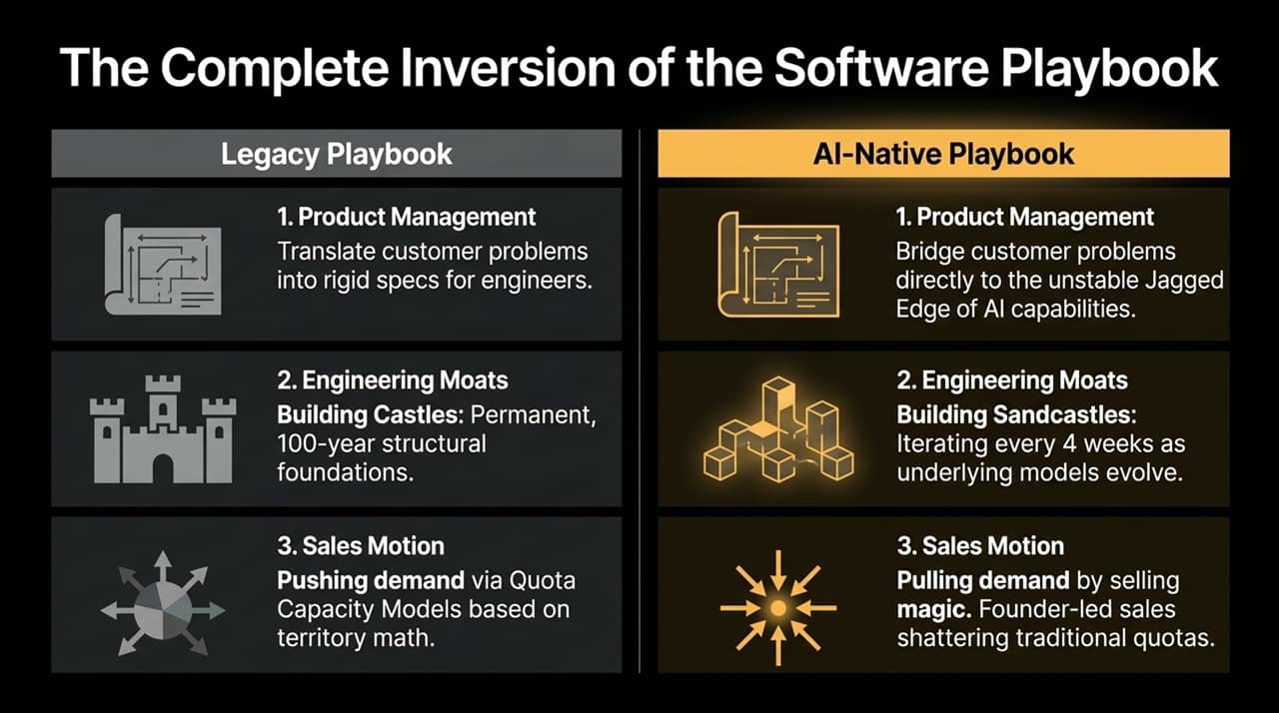
Notes:
Overview: The transition from SaaS to AI-Native isn't an incremental update; it's a structural inversion of product development, moat-building, and sales.
1. Product Management:
Legacy: PMs write rigid specification documents to translate customer needs into code.
AI-Native: PMs must intimately understand and bridge customer problems directly to the Jagged Edge of AI capability—where models excel at complex logic one second, but fail at simple tasks the next.
2. Engineering Moats ("Castles vs. Sandcastles"):
Legacy: Artisanal engineering focused on 100-year permanent structural foundations.
AI-Native: Building Sandcastles. Every 4 weeks, base model upgrades render old architectures obsolete. Teams must embrace building software that gets washed away and rebuilt constantly.
3. Sales Motion:
Legacy: Pushing demand through rigid quota capacity models (territory math, $1.5M–$2.5M quotas).
AI-Native: Pulling demand by "selling magic". Founder-led sales are shattering traditional metrics, with individual reps closing tens of millions in ARR because buyers are pulling the product in.

Slide 5
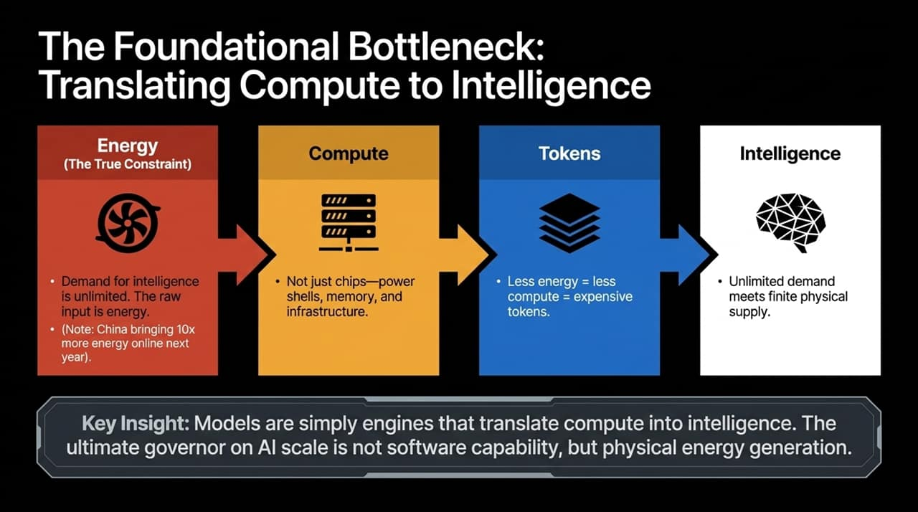
Notes:
The Core Mechanism: At a fundamental level, AI models are simply engines that translate compute into intelligence.
Unlimited Demand vs. Physical Supply:
Global demand for intelligence is virtually infinite.
The raw input required to generate compute is physical Energy.
The Geopolitical & Infrastructure Challenge:
Energy is the ultimate physical constraint—not just GPU availability, but power availability, grid hookups, memory bandwidth, and physical power shells.
For context, China is projected to bring online roughly 10x more energy capacity next year than the US.
Conclusion: Less energy directly equals less compute, leading to scarce or expensive tokens. The governor on AI scale is governed by physical thermodynamics, not software limits.

Slide 6
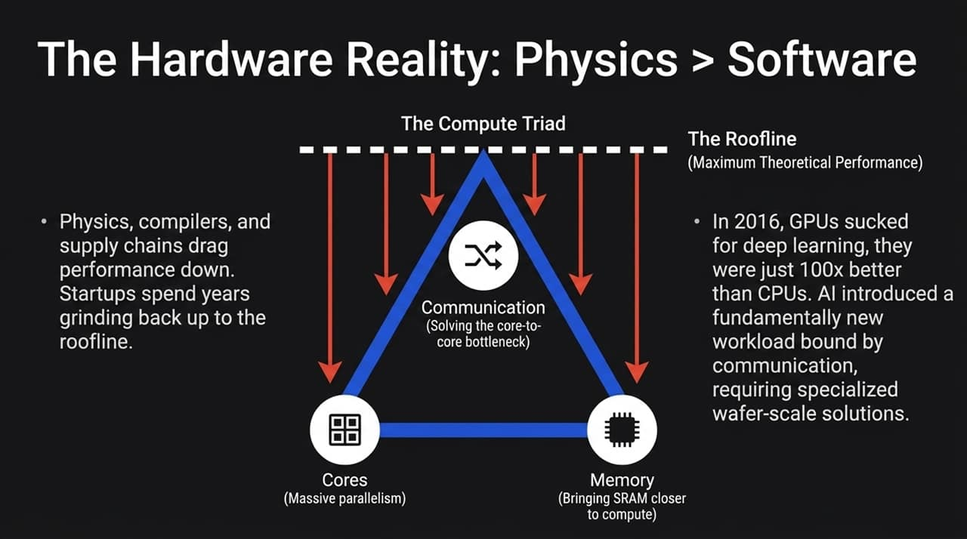
Notes:
Insights from Cerebras: Eric Vishria’s experience investing in Cerebras back in 2016 highlights the stark reality of hardware development.
The Compute Triad: Hardware speedups rely on three fundamental levers:
Cores: Massive parallelism.
Memory: Bringing SRAM/DRAM directly adjacent to compute.
Communication: Solving core-to-core communication bottlenecks across the wafer.
The Nature of Hardware Workloads: In 2016, GPUs were not designed for deep learning; they were just 100x better than CPUs. AI workloads are uniquely communication-bound, requiring custom wafer-scale architectures.
The "Roofline" Concept:
In software design, a clean block diagram gets you 80% of the way there.
In hardware, design simulations establish the theoretical performance limit—the "Roofline". Once physical silicon arrives, real-world drag (compilers, thermal limits, compilers, physics) drops performance down to ~10% of theoretical capacity. Teams spend years grinding through software layers just to climb back up toward the roofline.

Slide 7
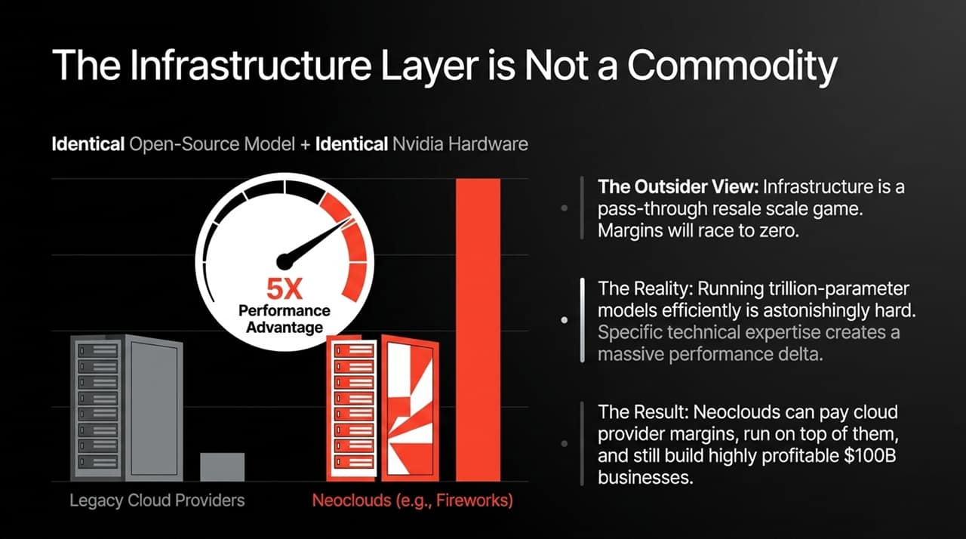
Notes:
The Common Misconception: Outsiders view AI infrastructure as a simple pass-through resale game where scale drives prices down and gross margins race to zero.
The Reality (Fireworks Case Study):
Running 70B to trillion-parameter models efficiently is extraordinarily difficult.
Take an identical open-source model running on identical Nvidia hardware. A specialized provider like Fireworks can achieve a 5x performance advantage in speed and significantly higher token throughput compared to standard cloud providers.
Economic Implication: Because of this deep optimization, Neoclouds can pay full cloud provider margins, run on top of hyperscaler infrastructure, and still build highly profitable, $100B standalone businesses. Expertise creates a massive performance delta.

Slide 8
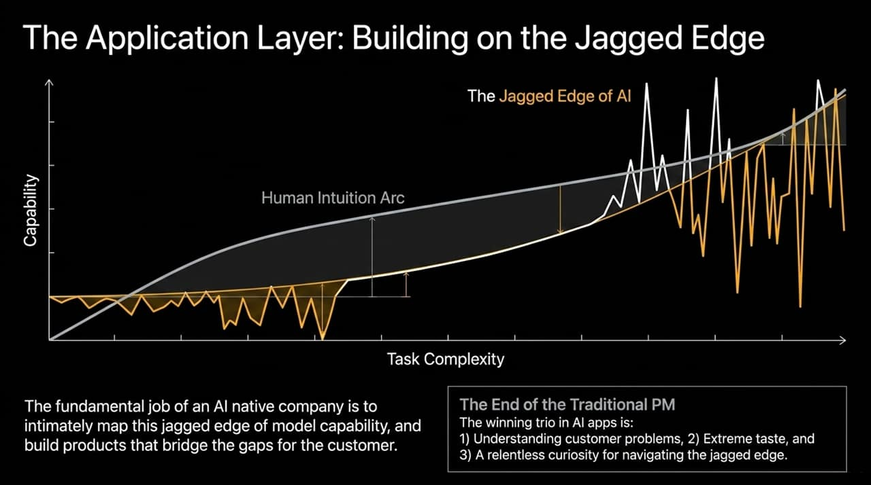
Notes:
Defining the Jagged Edge: Human capability follows a smooth, predictable arc relative to task complexity. AI model capabilities do not. A model might solve complex legal analysis instantly, but fail at simple spatial reasoning or counting—this creates a Jagged Edge.
The Role of AI Applications: The essential job of an AI-native company (e.g., Cursor, Sierra) is to intimately map this jagged frontier and build products/harnesses that bridge those capability gaps for end users.
The Evolution of winning teams:
Traditional PM roles are blurring.
Winning teams rely on three core pillars:
Deep understanding of real customer problems.
Extreme product taste.
Relentless curiosity to explore and navigate the shifting jagged edge.

Slide 9
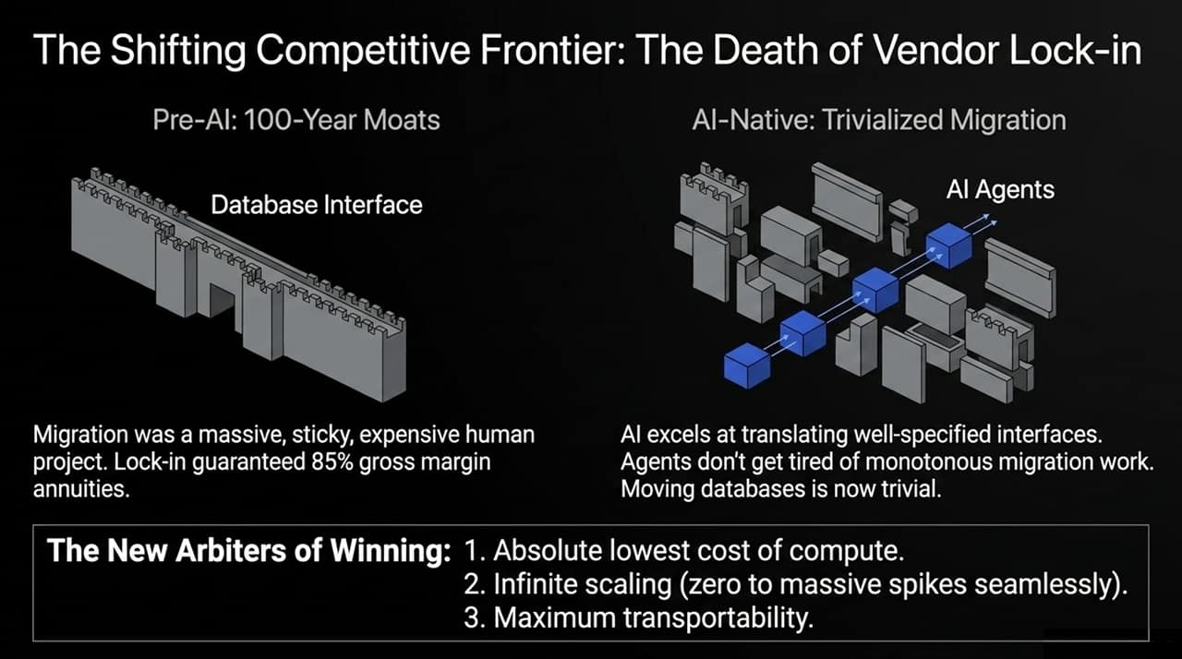
Notes:
Pre-AI Moats (The Database Example): Historically, databases were the ultimate sticky business with 85% gross margins. Why? Developers built rigid applications around specific database interfaces. Migrating databases required huge engineering teams and millions of dollars, making lock-in nearly permanent.
The AI Disruption:
AI agents excel at translating well-specified interfaces.
Crucially, AI agents don't get tired of monotonous migration work.
Database code translation and schema migration have become trivial tasks.
The New Rules for Winning: When lock-in evaporates, structural moat criteria fundamentally change:
Absolute lowest cost of compute.
Infinite scaling capabilities (from zero usage up to massive spikes seamlessly).
Maximum transportability.

Slide 10
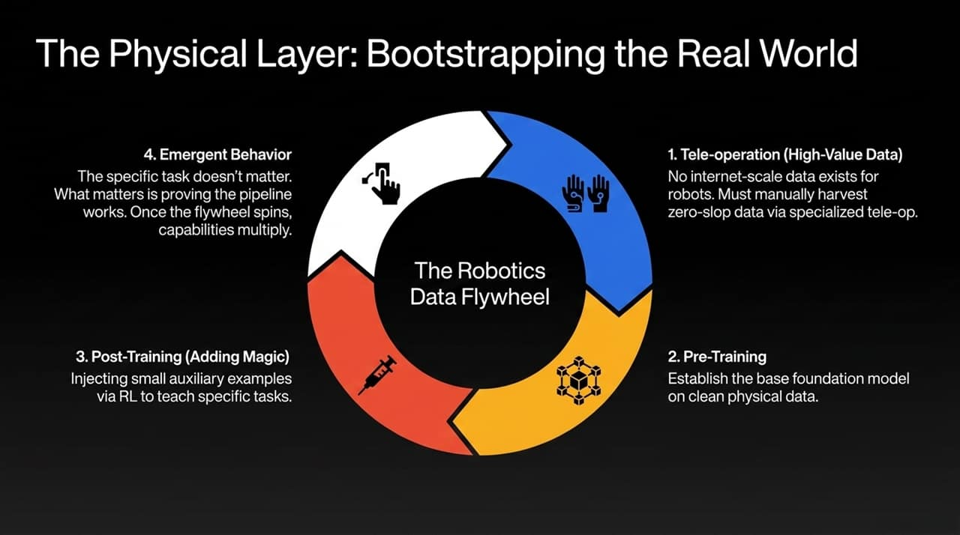
Notes:
The Robotics Data Challenge: Unlike LLMs, which were bootstrapped on massive internet text datasets, no internet-scale dataset exists for physical robotic manipulation.
The Robotics Data Flywheel Pipeline:
Tele-operation: Harvesting clean, zero-slop physical data using specialized tele-op setups (e.g., Sunday Robotics using custom glove/hand pairings).
Pre-Training: Training base foundation models on high-value physical interaction data.
Post-Training (Adding Magic): Using Reinforcement Learning (RL) and small auxiliary datasets to teach robots complex, new tasks.
Emergent Behavior: It doesn't matter if the initial task is folding laundry. What matters is proving the pipeline works—once the training flywheel spins, generalized physical capabilities multiply.

Slide 11
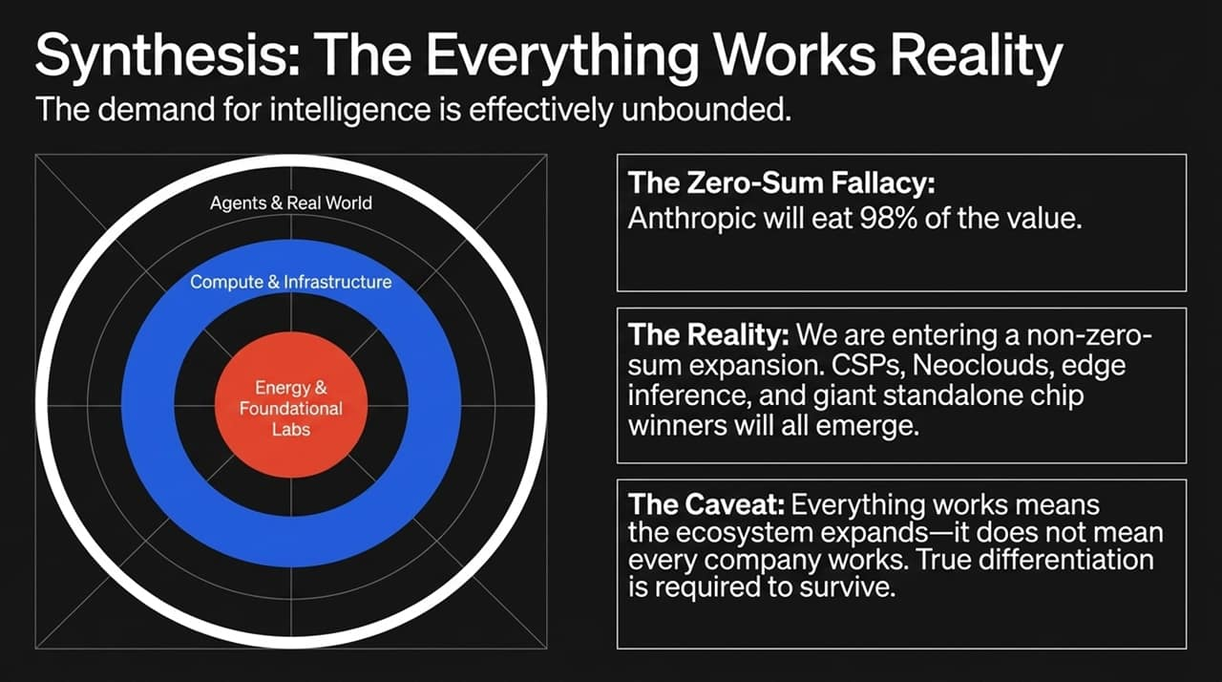
Notes:
The Expansionary Reality: We are entering a non-zero-sum expansion. Demand for intelligence is unbounded.
Ecosystem Growth: Value will not concentrate in just one layer. Hyperscalers (CSPs), specialized Neoclouds, edge inference platforms, robotics, and standalone chip makers will all thrive simultaneously.
The Caveat: "Everything works" refers to the expansion of the overall market, NOT that every individual company will succeed. Because barrier to entry is lower, true technical and functional differentiation is more critical than ever to avoid being run over.

Slide 12
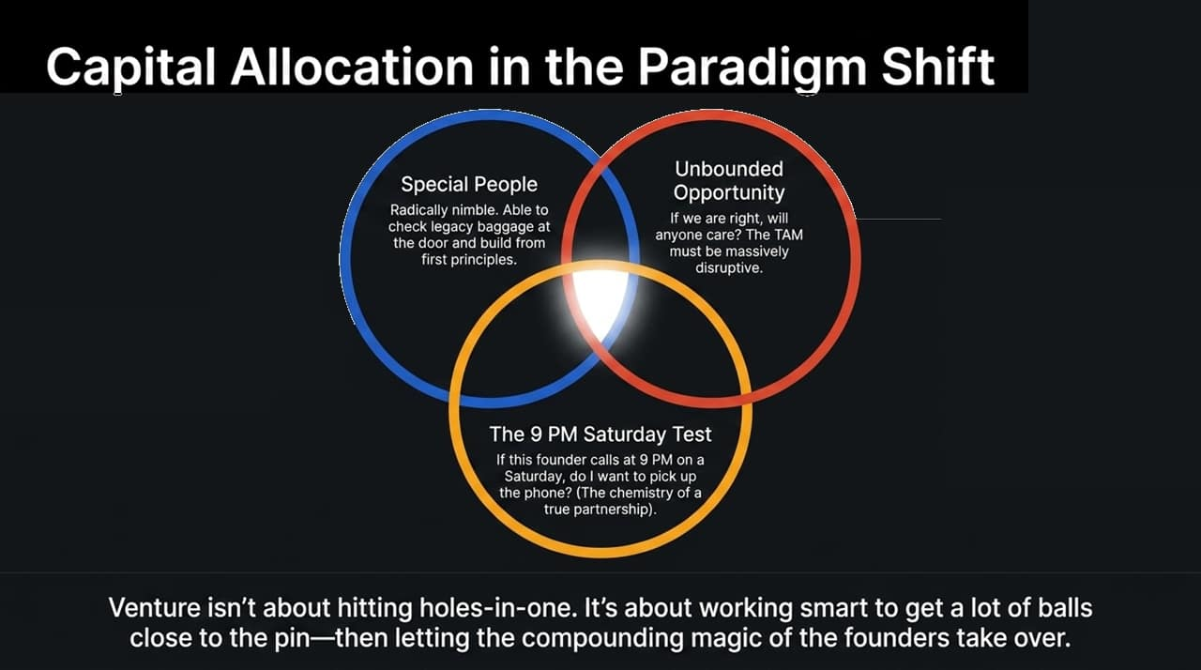
Notes:
Evaluating Opportunities in AI: How venture capital must evaluate investments in this new paradigm:
Special People: Radically nimble founders who check legacy baggage at the door and build from first principles.
Unbounded Opportunity: Asking the core question: "If we are right, will anyone care?" The TAM must be massive and disruptive.
The 9 PM Saturday Test ("Green Button Test"): Do you have the chemistry where, if the founder calls at 9 PM on a Saturday night, you are excited to pick up the phone?
Venture Philosophy: Venture capital is not about trying to hit a hole-in-one on every swing. It’s about working hard to get as many balls close to the pin as possible—and letting the compounding magic of exceptional founders take over.

Slide 13
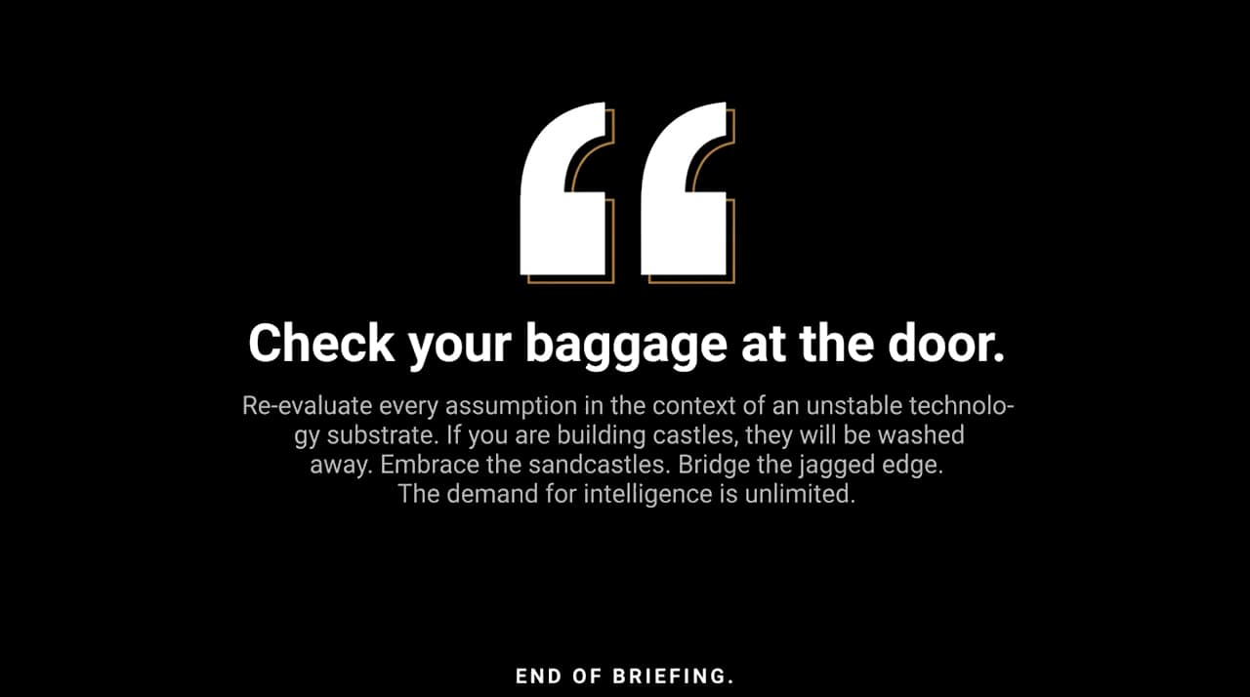
Notes:
Key Principles to Remember:
Check your baggage at the door: Question every assumption learned during the SaaS era.
Embrace the Sandcastles: Don't spend years building static "castles" when the underlying model capabilities evolve every 4 weeks.
Bridge the Jagged Edge: Value creation lives where human taste meets AI's non-linear capabilities.
Demand is Unlimited: Intelligence is the new universal input—build for scale.

Slide 14
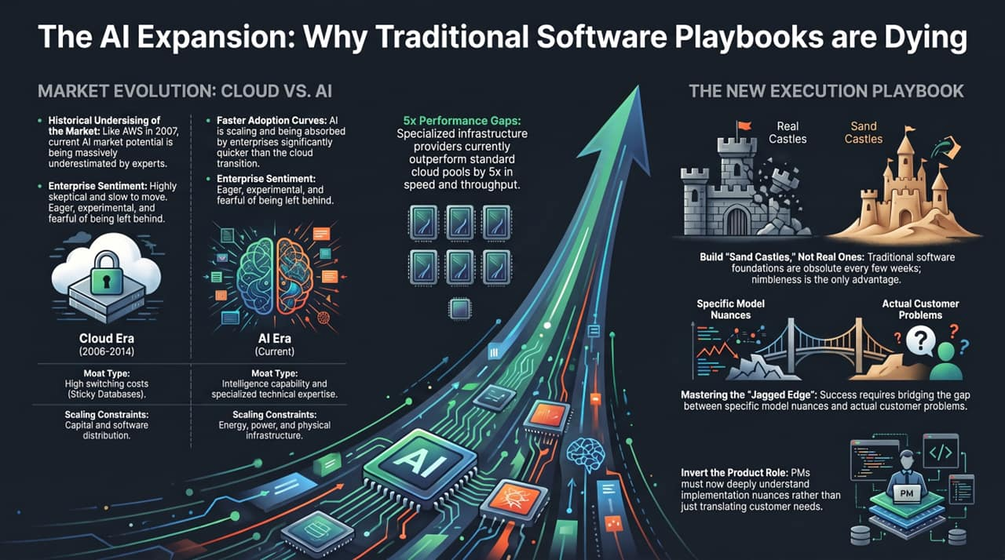
Notes:
Market Evolution Recap:
Cloud vs. AI: Enterprise adoption of AI is happening exponentially faster than cloud adoption did. Enterprise leaders aren't skeptical; they are eager, running experiments, and terrified of being left behind.
Performance Delta: Specialized infrastructure yields 5x performance and throughput gains over generic cloud pools.
Execution Summary:
Shift focus from rigid infrastructure to agile "Sandcastles."
Act as an "AI Sherpa" for enterprise clients to help them bridge the adoption gap and navigate model progress.

